Slide 1
Anomaly Detection in Grids
Will, 14-Feb-2021

Slide 2
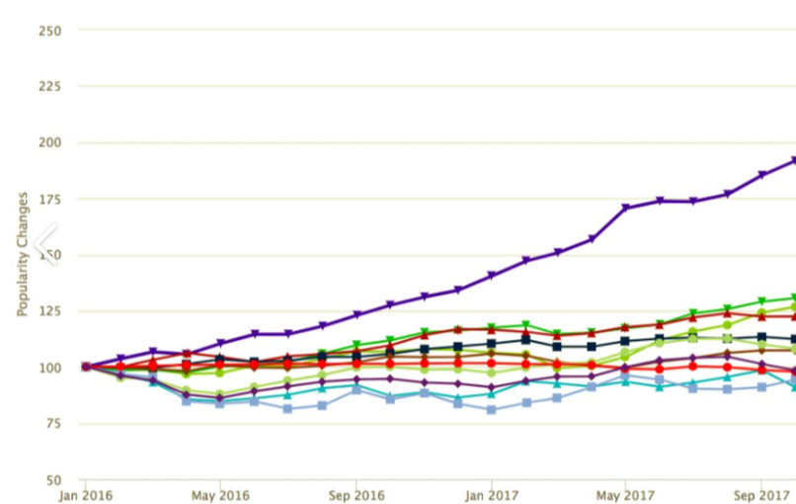
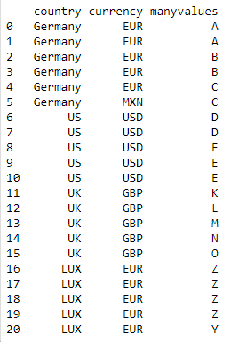
Data Types
Timeseries Data
Tabular Data

Slide 3
What Can Go Wrong with Tabular Data
Schema Changes
Columns added
Columns deleted
Columns change name
Columns change format/datatype
Key Changes
Too many new rows
Too many deleted rows
Data changes
Single cells out of range
Whole column goes wrong (all blank, big increase, big decrease)
These can all be spotted by comparing “typical” changes (e.g. daily) and comparing with latest change.

Slide 4
What Can Go Wrong with Tabular Data
Data internally inconsistent
Looking at the data, a human can tell you some subset of cells look wrong
Trade ID | Country | Currency
1 | USA | USD
2 | USA | USD
3 | USA | USD
4 | USA | USD
5 | USA | USD
6 | Germany | EUR
7 | Germany | EUR
8 | Germany | EUR
9 | Germany | USD
10 | Germany | EUR

Slide 5
How Can We Spot This?
Predict Every Cell, Compare
Observed
Predicted
Anomaly
Trade ID | Country | Currency
1 | USA | USD
2 | USA | USD
3 | USA | USD
4 | USA | USD
5 | USA | USD
6 | Germany | EUR
7 | Germany | EUR
8 | Germany | EUR
9 | Germany | USD
10 | Germany | EUR
Trade ID | Country | Currency
1 | USA | USD
2 | USA | USD
3 | USA | USD
4 | USA | USD
5 | USA | USD
6 | Germany | EUR
7 | Germany | EUR
8 | Germany | EUR
9 | Germany | EUR
10 | Germany | EUR
Trade ID | Country | Currency
1
2
3
4
5
6
7
8
9 |  | true
10

Slide 6
How Do We Do This?
For every column ‘c’, we train a classifier / regressor model on the entire dataset such that the other columns are the inputs ‘x’ and the output ‘y’ is the column ‘c’.
We then predict column ‘c’ for each row.
Model 1
Model 2
Input Columns
Output Column
Input Columns
Output Column
Trade ID | Country |  | Currency
1 | USA |  | USD
2 | USA |  | USD
3 | USA |  | USD
4 | USA |  | USD
5 | USA |  | USD
6 | Germany |  | EUR
7 | Germany |  | EUR
8 | Germany |  | EUR
9 | Germany |  | EUR
10 | Germany |  | EUR
Trade ID | Currency |  | Country
1 | USD |  | USA
2 | USD |  | USA
3 | USD |  | USA
4 | USD |  | USA
5 | USD |  | USA
6 | EUR |  | Germany
7 | EUR |  | Germany
8 | EUR |  | Germany
9 | EUR |  | Germany
10 | EUR |  | Germany

Slide 7
How Do We Do This?
We also need to know how certain our predictions are. There’s no point saying ‘A’ should be ‘B’ if ‘B’ is a random guess. Here, we should say just ‘A’ looks wrong.
We run our models N times (e.g. N=10) with a different subset of the rows to establish a variance for each prediction.
Full Dataset
Model 1 Run 1
Model 1 Run 2
Input Columns
Output Column
Trade ID | Country |  | Currency
1 | USA |  | USD
2 | USA |  | USD
3 | USA |  | USD
4 | USA |  | USD
5 | USA |  | USD
6 | Germany |  | EUR
7 | Germany |  | EUR
8 | Germany |  | EUR
9 | Germany |  | USD
10 | Germany |  | USD
Trade ID | Country |  | Currency
1 | USA |  | USD
2 | USA |  | USD
4 | USA |  | USD
6 | Germany |  | EUR
7 | Germany |  | EUR
8 | Germany |  | EUR
Trade ID | Country |  | Currency
1 | USA |  | USD
3 | USA |  | USD
4 | USA |  | USD
8 | Germany |  | EUR
9 | Germany |  | USD
10 | Germany |  | USD

Slide 8
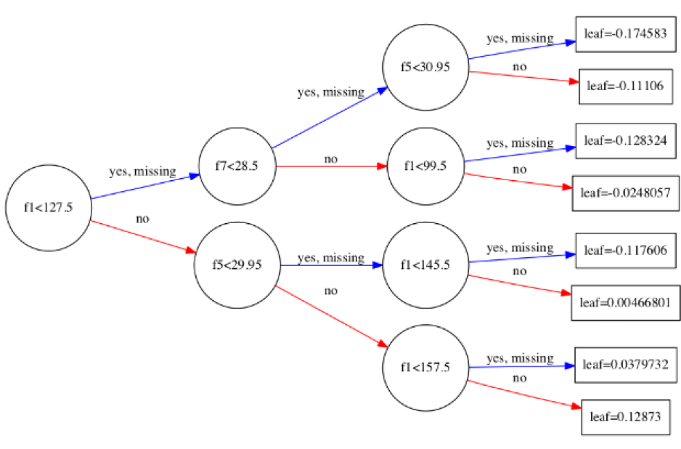
Internals
We use XGBClassifier because:
it’s fast
it runs on CPU or GPU
It produces ‘white box’ predictions telling you which columns were used to make a prediction and even how the prediction worked (some kind of parse tree)
This adds ‘explainability’ which is usually required if you tell somebody their data is wrong, you need why you think the value is different from what they say.
Crucially, most people approach this problem with neural networks which say ‘what’ but not ‘why’.
Example XGBoost Decision Tree

Slide 9
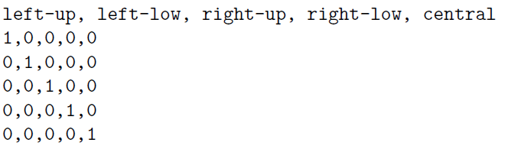
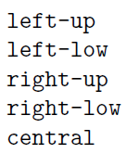

Complications
Neural Networks (and XGBoost) typically only take numeric data in and report numeric data out.
We have to encode all non-numeric fields:
One-Hot:
Works well but only if field doesn’t have too many
distinct values
Categorical:
Better if there are many categories (prevents explosion of columns) but the model may try to find unintended relationships between the numbers based solely on their new values.

Slide 10
Extensions in Finance
A lot of fields encode more information that being a simple label.
GBP
EUR
NOK
CHF
SEK
XAU
XAG
A-123
A-144
A-143
A-545
B-374
B-473
B-432
MICROSOFT 4% 31/12/2024
MICROSOFT 3.75% 30/7/2030
MICROSOFT 3 1/2 % 4/4/2049
MICROSOFT 4.05% PERPETUAL
GOOGLE 1.04% 31/4/2060
We should probably parse this into 2 in case the letter part and the numeric part are useful separately.
Powerful parsing may be required here, we should try to recognise numerics and dates and split them out.
We know the top 5 currencies are European currencies, the bottom 2 are precious metals. Does that help the model learn?

